Slide 1





FE 520
Introduction to Python for Financial Applications
TEAM 22 FINAL PROJECT​
Analyze Stock Performance for Smarter Investing
​
Sushil Bhandary Jay Bhesania Sabitha Rachel Nazareth Khyati Visavadiya

Slide 2

INTRODUCTION
Analyze Stock Performance for Smarter Investing
Our Tool is a Python package meticulously crafted to cater to the needs of investors and financial enthusiasts.
Key Components:
Data Analysis:
Comprehensive analysis of historical stock data.
Insights into trends, moving averages, and valuation assessments.
User-Friendly Interface:
Intuitive design for users with varying levels of expertise.
Simplifies complex financial analyses into actionable insights.

Slide 3
PROBLEM AND SOLUTION
Problem:
Investors and traders face the challenge of analyzing vast amounts of market data to make informed decisions.
Need for a user-friendly, efficient tool that can simplify this process by providing quick and accurate analysis of stock performance.
Solutions:
Helps users analyze historical stock performance using technical analysis methods like moving averages and trend lines.
Identifies potential buying or waiting opportunities based on the stock's current valuation relative to its moving averages.
Facilitates comparison of the chosen stock's performance with S&P 500 or another user-specified ticker.

Slide 4
PACKAGE INTRODUCTION
Purpose of the Package:
This application is designed to empower users, offering a potent yet user-friendly tool for making well-informed investment decisions. Whether you're a seasoned investor or a beginner, the package facilitates a comprehensive understanding and evaluation of stock performance.
Target Audience:
The primary audience includes investors seeking robust analytical tools, financial analysts aiming for insightful data, and anyone with an interest in gaining profound insights into stock market trends.
Domain: Stock Market Analysis:
The package operates within the domain of stock market analysis, providing essential tools for: Trend Analysis, Moving Averages, Comparative Performance Evaluations.

Slide 5
PROJECT OBJECTIVES
Apply Python Programming Skills:
Objective: Utilize Python for real-world problem-solving.
Explanation: This project serves as a practical application of our Python programming skills acquired during the course. By solving a real-world problem, we aim to demonstrate proficiency in using Python for data analysis and manipulation.
Design and Implement a Python Package:
Objective: Develop modular components for stock market analysis.
Explanation: Our objective is not just to write functional code but to design and implement a Python package structure. We'll organize the code into modules and functions, ensuring modularity, scalability, and readability. This aligns with best practices in software development.
Handle Real-world Data:
Objective: Retrieve historical stock data using the Yahoo Finance API.
Explanation: Dealing with real-world data is a crucial skill. We'll use the Yahoo Finance API to fetch historical stock data spanning the past 10 years. This involves data retrieval, cleaning, and preprocessing to ensure meaningful analysis.

Slide 6
PACKAGE FUNCTIONALITIES
Data Collection:
Utilize the yfinance library to fetch historical stock data over the past 10 years.
Moving Average Analysis:
Calculate 50-day and 200-day moving averages for stock valuation.
Stock Valuation Assessment:
Determine current price, 50-day MA, and 200-day MA.
Provide advice on stock valuation based on relationships between the current price and moving averages.
Stock Performance Comparison:
Compare stock performance against the S&P 500 or another specified stock.
Visualization:
Plot stock prices and moving averages over time using matplotlib.

Slide 7
PACKAGE USED
import yfinance as yf - Import yfinance library for Yahoo Finance API access
import matplotlib.pyplot as plt - Import matplotlib's pyplot module for plotting
import matplotlib.dates as mdates - Importing matplotlib's dates module for date handling
import numpy as np - Importing numpy for numerical computations

Slide 8
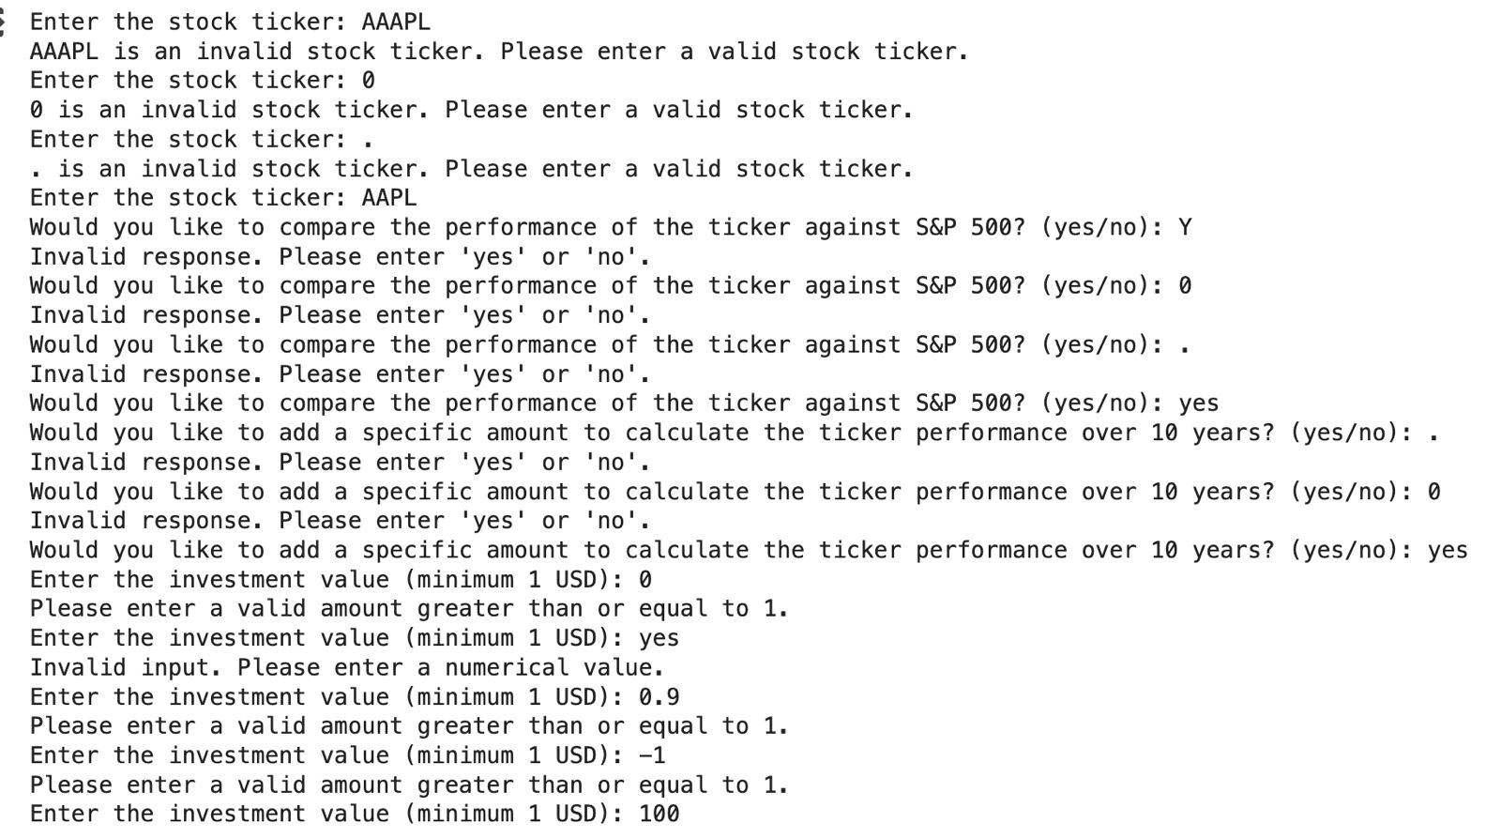
ROBUSTNESS
The code uses try-except blocks to handle potential errors during data fetching, calculation, and user input validation.
It informs the user about any issues encountered and provides clear error messages.
It validates user input for ticker symbols and ensures they are valid before fetching data.

Slide 9
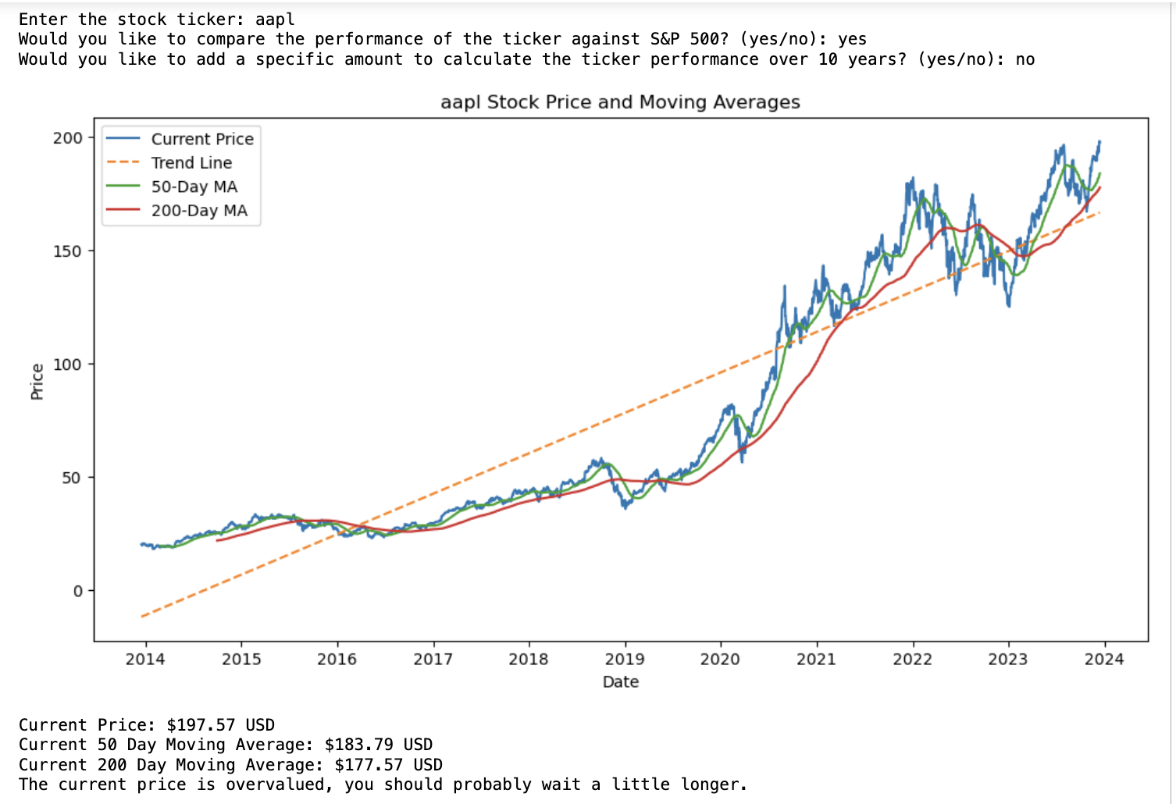
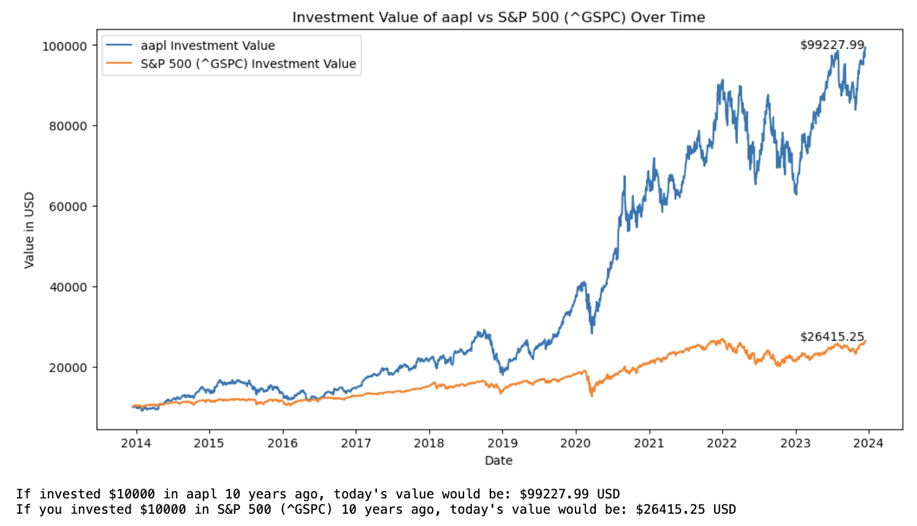
PROEJCT OUTPUT - 1

Slide 10
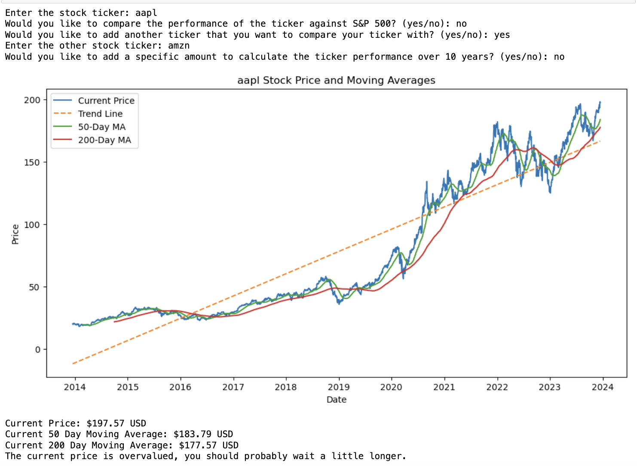
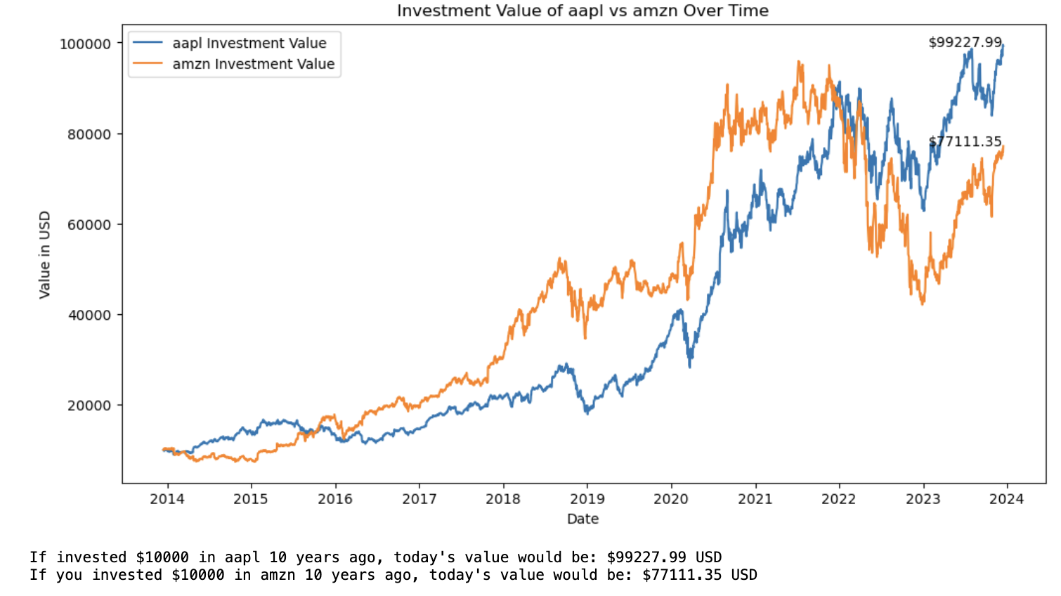
PROEJCT OUTPUT - 2

Slide 11
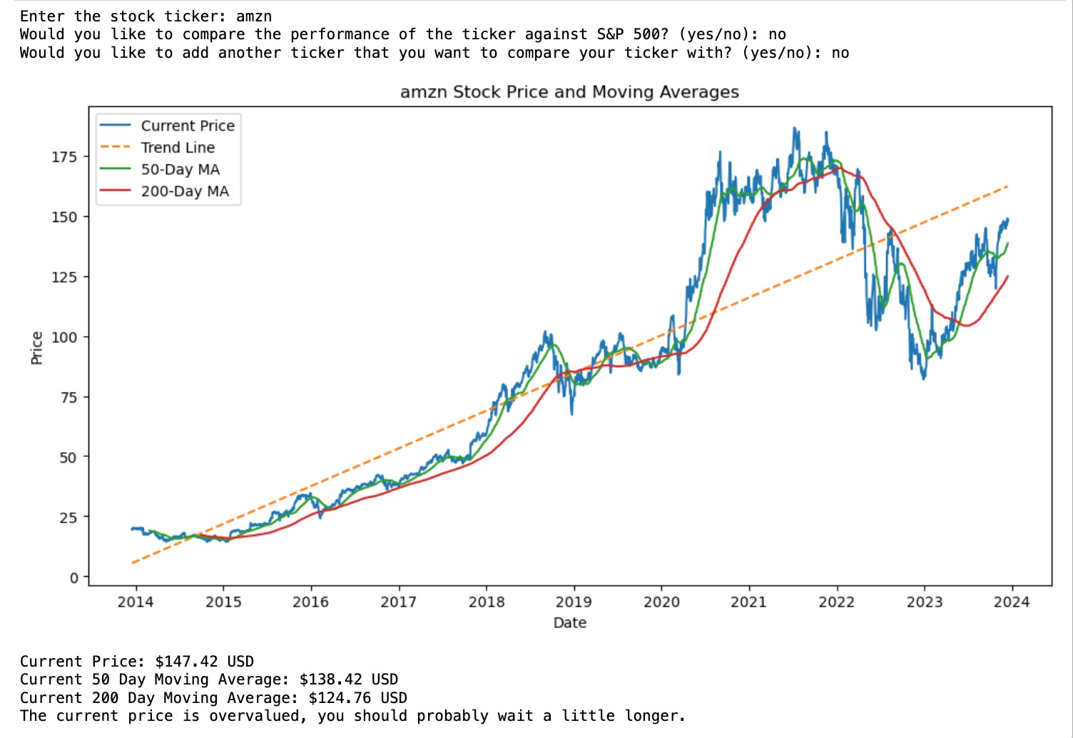
PROEJCT OUTPUT - 3

Slide 12
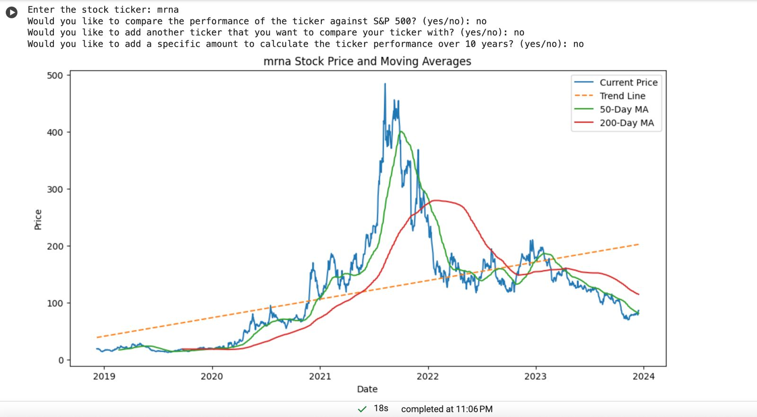
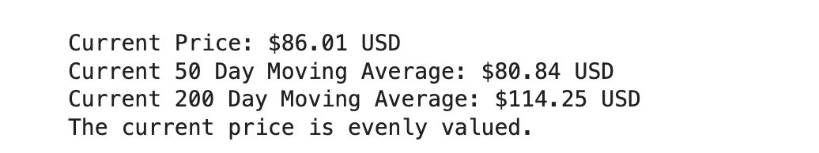
PROEJCT OUTPUT - 4

Slide 13
CONTRIBUTIONS
Sushil Rajeeva Bhandary:
Contributed to the design and implementation of the Data Collection Function (user input).
Developed error handling strategies, main function and refactoring the code.
Prepared the project documentation
Sabitha Rachel Nazareth:
Implemented the function that evaluates the stock valuation against Moving Averages.
Developed graph functions to visualize the stock valuations.
Prepared the project documentation
Jay Jagdish Bhesania:
Implemented Moving Average Trend
Collaborated on stock valuation assessments.
Prepared the presentation and report.
Khyati Visavadiya:
Contributed to the Stock Performance Comparison Function.
Collaborated on the Visualization Function using matplotlib.
Prepared the presentation and report.

Slide 14
Thank You

